Slide 1

ADVAnce C++

Slide 2
MODERN C++
Categories Of Member Functions In Vector
Various Ways Of Iterating Over A Vector
Accessing A Vector
Sizing/Resizing A Vector
Manipulating A Vector

Slide 3
Categories Of Member functions of vector
The member functions of vector are basically divided into 4 categories.
These categories represent the type of operations these functions can perform and they are :
Iteration
Accessors
Capacity
Modifiers

Slide 4
Iterator functions
Member Function | Description
begin() | Returns an iterator pointing to the beginning element of the vector.
end() | Returns an iterator pointing to the general element that follows the end element of the vector.
rbegin() | Returns a reverse iterator pointing to the end element in the vector
rend() | Returns a reverse iterator pointing to the general element preceding the first element in the vector

Slide 5
Iterator functions
Member Function | Description
cbegin() | Returns a constant iterator to the beginning element of the vector.
cend() | Returns a constant iterator pointing to the general element that follows the end element of the vector.
crbegin() | Returns a constant reverse iterator pointing to the end element in the vector
crend() | Returns a constant reverse iterator pointing to the general element preceding the first element in the vector.

Slide 6
Forward & backward iterating
OUTPUT:
Forward Iteration: 10 20 30 40 50
Backward Iteration: 50 40 30 20 10
#include <iostream>
#include <vector>
using namespace std;
int main()
{
vector <int> v{10,20,30,40,50};
cout<<"Forward iteration: ";
for (auto i = v.begin(); i != v.end(); ++i)
cout<< *i << "\t";
cout<<endl<<"Backward iteration: ";
for (auto j = v.rbegin(); j != v.rend(); ++j)
cout << *j << "\t";
return 0;
}

Slide 7
Constant iterator
OUTPUT:
Forward Iteration: 10 20 30 40 50
Backward Iteration: 50 40 30 20 10
#include <iostream>
#include <vector>
using namespace std;
int main()
{
vector <int> v{10,20,30,40,50};
cout<<"Forward iteration: ";
for (auto i = v.cbegin(); i != v.cend(); ++i)
cout<< *i << "\t";
cout<<endl<<"Backward iteration: ";
for (auto j = v.crbegin(); j != v.crend(); ++j)
cout << *j << "\t";
return 0;
}

Slide 8
Manipulating using iterator
OUTPUT:
Iterating and manipulating: 10 20 30 40 50
Iterating again: 11 21 31 41 51
#include <iostream>
#include <vector>
using namespace std;
int main()
{
vector <int> v{10,20,30,40,50};
cout<<"Iterating and manipulating: ";
for (auto i = v.begin(); i != v.end(); ++i)
cout<<(*i)++<<"\t";
cout<<endl<<"Iterating again: ";
for (auto i = v.begin(); i != v.end(); ++i)
cout<<*i<<"\t";
return 0;
}

Slide 9
Manipulating while reverse iterating
OUTPUT:
Reverse Iterating and manipulating: 50 40 30 20 10
Reverse Iterating again: 51 41 31 21 11
#include <iostream>
#include <vector>
using namespace std;
int main()
{
vector <int> v{10,20,30,40,50};
cout<<"Reverse Iterating and manipulating: ";
for (auto i = v.rbegin(); i != v.rend(); ++i)
cout<<(*i)++<<"\t";
cout<<endl<<"Reverse Iterating again: ";
for (auto i = v.rbegin(); i != v.rend(); ++i)
cout<<*i<<"\t";
return 0;
}

Slide 10
Manipulating using constant iterator
#include <iostream>
#include <vector>
using namespace std;
int main()
{
vector <int> v{10,20,30,40,50};
cout<<"Constant Iterating and manipulating: ";
for (auto i = v.cbegin(); i != v.cend(); ++i)
cout<<(*i)++<<"\t";
cout<<endl<<"Iterating again: ";
for (auto i = v.cbegin(); i != v.cend(); ++i)
cout<<*i<<"\t";
return 0;
}
OUTPUT:
Error: increment of read only location

Slide 11
Manipulating using reverse constant iterator
#include <iostream>
#include <vector>
using namespace std;
int main()
{
vector <int> v{10,20,30,40,50};
cout<<"Constant Reverse Iterating and manipulating: ";
for (auto i = v.crbegin(); i != v.crend(); ++i)
cout<<(*i)++<<"\t"; // will give error
cout<<endl<<"Reverse Iterating again: ";
for (auto i = v.crbegin(); i != v.crend(); ++i)
cout<<*i<<"\t";
return 0;
}
OUTPUT:
Error: increment of read only location

Slide 12
Accessor functions
Member Function | Description
front() | Returns the first element of the vector
back() | Returns the last element of the vector
data() | Returns the pointer to the array implemented internally by vector.
at(i) | Accesses the element stored at index ’i’.
[i] | Accesses the element stored at index ’i’.

Slide 13
Accessing a vector
#include <iostream>
#include <vector>
using namespace std;
int main()
{
vector <int> v{10,20,30,40,50};
cout<<endl<<"Using the subscript operator v[3]:" << v[3];
cout<<endl<<"Using the at(n) function : at(3) = " << v.at(3);
cout<<endl<<"Using the front() function : front() = " << v.front();
cout<<endl<<"Using the back() function: back() = " << v.back();
int* p = v.data(); // Pointer to the first element
cout<<endl<<"The first element of the vector is " << *p<<endl;
return 0;
}
OUTPUT:
Using the subscript operator v[3] : 40
Using the at(n) function : at(3)=40
Using the front() function : front()=10
Using the back() function : back()=50
The first element of vector is 10

Slide 14
Accessing a vector
OUTPUT:
vector contains: 10 20 0 100 0
#include <iostream>
#include <iostream>
#include <vector>
int main ()
{
vector<int> v (5);
int* p = v.data();
*p = 10;
++p;
*p = 20;
p[2] = 100;
cout << "vector contains:";
for (int i=0; i<v.size(); ++i)
cout << ' ' << v[i];
return 0;
}

Slide 15
capacity functions
Member Function | Description
size() | This function is used to find out the number of elements in the vector.
max_size() | This function gives the maximum number of elements a vector can store.
capacity() | It gives the current storage space of the vector.
resize(n) | This function resizes the vector to the mentioned size.
empty() | This function is used to find out if the vector is empty.

Slide 16
capacity functions
Member Function | Description
shrink_to_fit() | This function reduces the vector to reduce its capacity and clears the elements that are beyond it.
reserve() | This function makes the vector capacity to hold a specified number of elements.

Slide 17
Size V/s Capacity
#include <iostream>
#include <vector>
using namespace std;
int main()
{
vector <int> v;
cout<<"Total space for v="<<sizeof(v)<<endl;
cout<<"size="<<v.size()<<",capacity="<<v.capacity()<<endl;
int x=10;
for(int i=1;i<=10;i++,x=x+10)
{
v.push_back(x);
cout<<"============================================"<<endl;
cout<<"After inserting "<<i<<" ele"<<endl;
cout<<"Total space for v="<<sizeof(v)<<endl;
cout<<"size="<<v.size()<<",capacity="<<v.capacity()<<endl;
}
return 0;
}

Slide 18
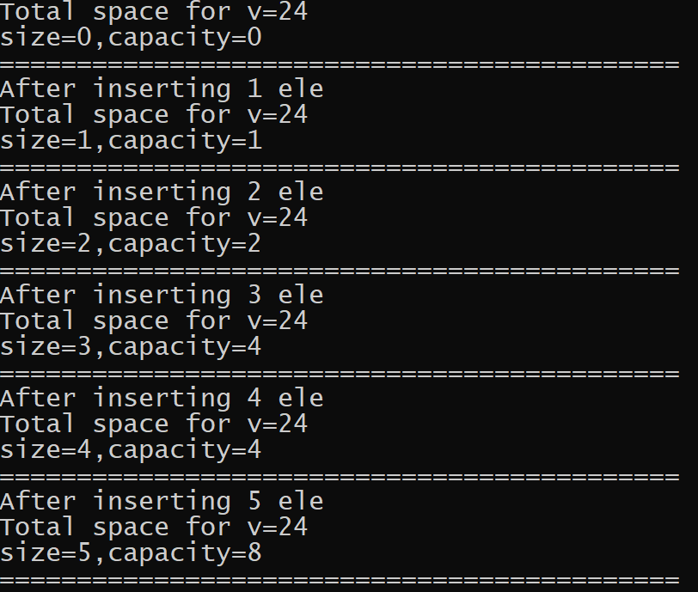
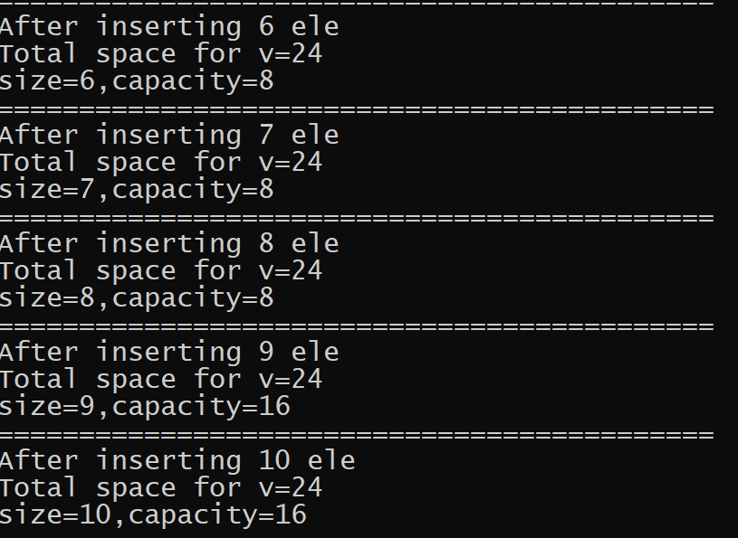
output

Slide 19
The resize() member function
This member function resizes the container so that it contains n elements.
It has the following version:
void resize(int n,type val=val_type)
n is the new size for the container.
val is the value to fill the container with

Slide 20
The resize() member function
If n is smaller than the current container size, the content is reduced to its first n elements, removing those beyond n.
If n is greater than the current container size, the content is expanded by inserting at the end as many elements as needed to reach a size of n. If val is specified, the new elements are initialized as copies of val, otherwise, they are value-initialized.
If n is also greater than the current container capacity, an automatic reallocation of the allocated storage space takes place.

Slide 21
Resizing a vector
#include <iostream>
#include <vector>
using namespace std;
int main()
{
vector<int> v;
for (int i=1;i<10;i++)
v.push_back(i);
v.resize(5);
v.resize(8,100);
v.resize(12);
for (int i=0;i<v.size();i++)
cout <<v[i]<<" ";
return 0;
}
OUTPUT:
1 2 3 4 5 100 100 100 0 0 0 0

Slide 22
Checking an empty vector
#include <iostream>
#include <vector>
using namespace std;
int main()
{
vector<int> v1;
vector<int> v2(5);
vector<int> v3(5,10);
cout<<"v1 is empty ?"<<v1.empty()<<endl;
cout<<"v2 is empty ?"<<v2.empty()<<endl;
cout<<"v3 is empty ?"<<v3.empty()<<endl;
return 0;
}
OUTPUT:
v1 is empty ? 1
v2 is empty ? 0
v3 is empty ? 0

Slide 23
Shrinking a vector
#include <iostream>
#include <vector>
using namespace std;
int main()
{
vector<int> v1;
int x=10;
for(int i=1;i<=10;i++,x+=10)
v1.push_back(x);
cout<<"Before shrinking:"<<endl;
cout<<"Size="<<v1.size()<<",Capacity="<<v1.capacity()<<endl;
v1.shrink_to_fit();
cout<<"After shrinking:"<<endl;
cout<<"Size="<<v1.size()<<",Capacity="<<v1.capacity()<<endl;
return 0;
}
OUTPUT:
Before shrinking
Size=10,Capacity=16
After shrinking
Size=10.Capacity=10

Slide 24
Modifier functions
Member Function | Description
assign() | This function is used to clear the existing values in the vector and replace it with new ones.
push_back() | This function is used to add an element to the vector from the back.
pop_back() | This function is used to remove an element to the vector from the back.
insert() | This function is used to insert an element into the vector.

Slide 25
Modifier functions
Member Function | Description
erase() | This function is used to remove an element from the vector.
swap() | This function is used to swap two vectors of the same data type.
clear() | This function is used to erase the elements in the vector.
emplace() | This function would extend the container by inserting a new element at the position.
emplace_back() | This function inserts a new element into the vector at the end .

Slide 26
The assign() member function
This member function assigns new contents to the vector, replacing its current contents, and modifying its size accordingly.
It has 2 versions:
void assign(int n,int val)
n is the new size for the container.
val is the value to fill the container with
void assign(iterator first,iterator last)
The range used is [first,last), which includes all the elements between first and last, including the element pointed by first but not the element pointed by last.

Slide 27
Assigning in a vector
#include <iostream>
#include <vector>
using namespace std;
int main()
{
vector<int> first;
vector<int> second;
vector<int> third;
first.assign (7,10);
vector<int>::iterator it;
it=first.begin()+1;
second.assign (it,first.end()-1);
int myarr[] = {10,20,30};
third.assign (myarr,myarr+3);
cout << "Size of first: " << first.size() << endl;
cout << "Size of second: " << second.size() << endl;
cout << "Size of third: " << third.size() << endl;
return 0;
}
OUTPUT:
Size of first : 7
Size of second: 5
Size of third: 3

Slide 28
Pushing & popping from vector
OUTPUT:
Size:0 Capacity:0
Size:5 Capacity:8
Size:0 Capacity:8
Size:0 Capacity:0
#include <iostream>
#include <vector>
using namespace std;
int main()
{
vector<int> v;
cout << "Size:"<< v.size()<<",Capacity:"<<v.capacity()<< endl;
for(int i=1;i<=5;i++)
v.push_back(1*10);
cout<<"Size:"<<v.size()<<",Capacity:"<<v.capacity()<<endl;
for(int i=1;i<=5;i++)
v.pop_back();
cout<<"Size:"<<v.size()<<",Capacity:"<<v.capacity()<<endl;
v.shrink_to_fit();
cout<<"Size:"<<v.size()<<",Capacity:"<<v.capacity()<<endl;
return 0;
}

Slide 29
programming challenge
Write a program to store some nos in a vector .
Now display the sum of all the elements of the vector.
Make sure your code neither uses iterators nor uses size() or capacity() member function nor range based for

Slide 30
solution
#include <iostream>
#include <vector>
using namespace std;
int main()
{
vector<int> v{10,4,15,8,9,11,6,3};
int sum=0;
while(!v.empty())
{
sum+=v.back();
v.pop_back();
}
cout<<"sum="<<sum;
return 0;
}

Slide 31
The insert() member function
This member function extends the vector by inserting new elements before the element at the specified position
It has 3 versions:
iterator insert(iterator pos,int val)
pos is the position in the vector where the new elements are to be inserted.
val is the value to be inserted.
void insert(iterator pos,int n,int val)
pos is the position in the vector where the new elements are to be inserted.
n is the number of elements to insert
val is the value to be inserted.

Slide 32
The insert() member function
void insert(iterator pos,iterator first,iterator last)
pos is the position in the vector where the new elements are to be inserted.
Copies of the elements in the range [first,last) are inserted at position (in the same order).
Notice that the range includes all the elements between first and last, including the element pointed by first but not the one pointed by last.

Slide 33
Inserting in a vector
OUTPUT:
v1 contains:501 502 503 300 300 400 400 200 100 100 100
#include <iostream>
#include <vector>
using namespace std;
int main()
{
vector<int> v1 (3,100);
vector<int>::iterator it;
it = v1.begin();
it = v1.insert ( it , 200 );
v1.insert (it,2,300);
// "it" no longer valid, get a new one:
it = v1.begin();
vector<int> v2 (2,400);
v1.insert (it+2,v2.begin(),v2.end());
int arr [] = { 501,502,503 };
v1.insert (v1.begin(), arr, arr+3);
cout << "v1 contains:";
for (it=v1.begin(); it!=v1.end(); it++)
cout << ' ' << *it;
return 0;
}

Slide 34
The erase() member function
This member function removes element(s) from the vector
It has 2 versions:
iterator erase(iterator pos)
pos is the position in the vector from where the element is to be deleted.
iterator erase(iterator first,iterator last)
The range used is [first,last), which includes all the elements between first and last, including the element pointed by first but not the element pointed by last.

Slide 35
erasing in a vector
OUTPUT:
v1 contains:4 5 7 8 9 10
#include <iostream>
#include <vector>
using namespace std;
int main()
{
vector<int> v1;
// set some values (from 1 to 10)
for (int i=1; i<=10; i++)
v1.push_back(i);
// erase the 6th element
v1.erase (v1.begin()+5);
// erase the first 3 elements:
v1.erase (v1.begin(),v1.begin()+3);
cout << "v1 contains:";
for (int i=0; i<v1.size(); ++i)
cout << ' ' << v1[i];
return 0;
}

Slide 36
SWAPPing in a vector
OUTPUT:
v1 contains:200 200 200 200 200
v2 contains: 100 100 100
#include <iostream>
#include <vector>
using namespace std;
int main()
{
vector<int> v1 (3,100);
vector<int> v2 (5,200);
v1.swap(v2);
cout << "v1 contains:";
for (int i=0; i<v1.size(); i++)
cout << ' ' << v1[i];
cout << endl;
cout << "v2 contains:";
for (int i=0; i<v2.size(); i++)
cout << ' ' << v2[i];
return 0;
}

Slide 37
How to swap elements in a vector ?
C++ provides us a global swap() function also , which can swap any two elements passed to it.
We can use it to swap two elements of a vector

Slide 38
SWAPPing two elements of a vector
OUTPUT:
10 20 40 30 50
#include <iostream>
#include <vector>
using namespace std;
int main()
{
vector<int> v={ 10, 20, 30, 40, 50 };
int i = 2, j = 3;
swap(v[i], v[j]);
for (int i: v) {
cout << i << ' ';
}
return 0;
}

Slide 39
What’s the difference ?
Global swap() Function | Vector’s swap() Member Function
It is a built-in function in C++ STL | The std::vector::swap() is a member function of vector class
It swaps the value of any two variables passed to it as parameters. | The std::vector::swap() exchanges the contents of one vector with another. It swaps the addresses(i.e. the containers exchange references to their data) of two vectors rather than swapping each element one by one which is done in constant time O(1).
Special Note:
If global swap() function is used for swapping two vectors A and B, then it internally calls
vector’s member function swap() as A.swap(B)
It means that both the functions will swap the contents of vectors in O(1) time and give the
same performance

Slide 40
Clearing a vector
OUTPUT:
Before clearing, size: 5,capacity:5
After clearing, size: 0,capacity:5
#include <iostream>
#include <vector>
using namespace std;
int main()
{
vector<int> v={ 10, 20, 30, 40, 50 };
cout<<"Before clearing, Size:"<<v.size()<<",Capacity:"<<v.capacity()<<endl;
v.clear();
cout<<"After clearing , Size:"<<v.size()<<",Capacity:"<<v.capacity()<<endl;
return 0;
}

Slide 41
The emplace() member function
This member function extends the container by inserting a new element at position. This new element is constructed in place using args as the arguments for its construction.
It has following version:
iterator emplace(iterator pos, Args. . .args)
pos is the position in the vector where the new elements are to be inserted.
args is arguments forwarded to construct the new element.

Slide 42
Using emplace()
OUTPUT:
vector contains: 10 200 100 20 30 300
#include <iostream>
#include <vector>
using namespace std;
int main()
{
vector<int> v = {10,20,30};
auto it = v.emplace ( v.begin()+1, 100 );
v.emplace ( it, 200 );
v.emplace ( v.end(), 300 );
cout << "vector contains:";
for (auto x: v)
cout << ' ' << x;
return 0;
}

Slide 43
How emplace() differs from insert() ?
The primary difference is that insert() takes an object whose type is the same as the container type and copies that argument into the container.
On the other hand emplace() takes an argument list and constructs an object in the container from those arguments.

Slide 44
Benefit ?
The advantage of emplace() is, it does in-place insertion and avoids an unnecessary copy of object.
For primitive data types, it does not matter which one we use.
But for objects, use of emplace() is preferred

Slide 45
How emplace() differs from Insert() ?
To be more clear, here is what will happen if we call insert():
A constructor will be called to create a temporary object.
A copy of the temporary object will be constructed in the memory for the container. Note that for this the copy constructor should be called.
The destructor will be called to destroy the temporary object after copy.

Slide 46
How emplace() differs from insert() ?
As a comparison, emplace() directly takes constructor arguments for objects to be inserted.
In other words, the emplacement function avoids constructing and destructing the temporary objects.
It will be much more efficient if developer tries to insert large amount of objects

Slide 47
The emplace_back() member function
This member function inserts a new element at the end of the vector, right after its current last element. This new element is constructed in place using args as the arguments for its constructor.
It has following version:
void emplace_back(Args. . .args)
args is arguments forwarded to construct the new element.

Slide 48
Using emplace_baCK()
OUTPUT:
vector contains: 10 20 30 100 200
#include <iostream>
#include <vector>
using namespace std;
int main()
{
vector<int> v = {10,20,30};
v.emplace_back (100);
v.emplace_back (200);
cout << "vector contains:";
for (auto x: v)
cout << ' ' << x;
return 0;
}

Slide 49
How emplace_back() differs from push_back() ?
push_back(val): Adds a new element at the end of the container, after its current last element. The content of val is copied to the new element.
emplace_back(args): Inserts a new element at the end of the container, right after its current last element. This new element is constructed in place using args as the arguments for its constructor.

Slide 50
How emplace_back() differs from push_back() ?
To be more clear, here is what will happen if we call push_back():
A constructor will be called to create a temporary object.
A copy of the temporary object will be constructed in the memory for the container. Note that for this the copy constructor should be called.
The destructor will be called to destroy the temporary object after copy.

Slide 51
How emplace_back() differs from push_back() ?
As a comparison, emplace_back() directly takes constructor arguments for objects to be inserted.
In other words, the emplacement function avoids constructing and destructing the temporary objects.
It will be much more efficient if developer tries to insert large amount of objects

